Slide 1
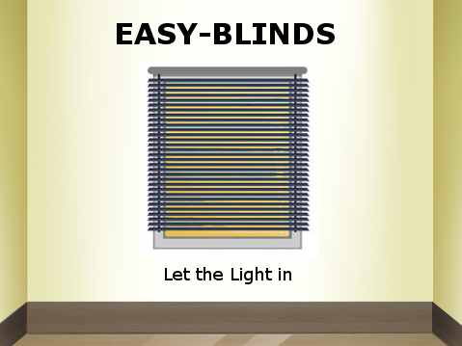
Gabriel Almeida
Ashraf Drieas
Brandon Fins
Juan Inzunza
Mandy Ledford

Slide 2
Ask yourself...

Slide 3

What is EASY-BLINDS
The next step in blinds technology
Easy-to-use, hands-free, all encompassing ambient light control system.
Control your blinds from anywhere in your home with your phone or your alexa assistant

Slide 4
Motivation behind Project
As discussed in class this quarter, Raspberry Pi has an abundance of different Communication capabilities available for use.
Expand capabilities of the original design with an emphasis on communication protocols.
Easy-Blinds allows use of several different sensors and communications which added many dimensions of functionality.

Slide 5

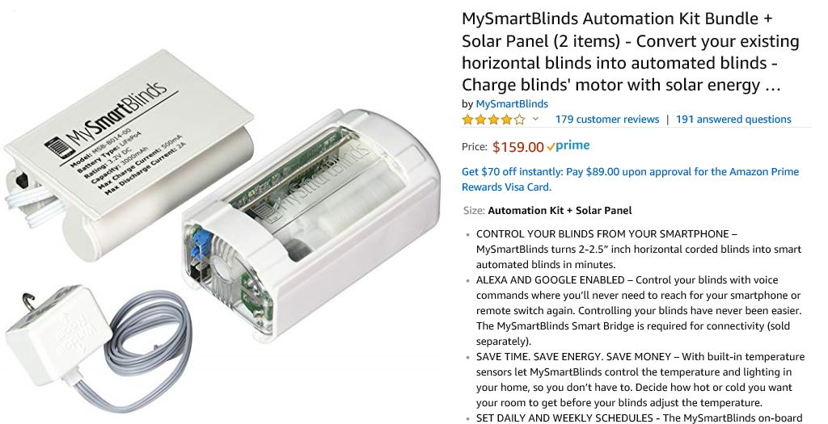
Products already on the Market
Regular Blinds
$25
Found in every home
No distinct features
MySmartBlinds
$159
Alexa Enabled
separate hardware kit that can be purchased and installed with current blinds
Smartphone App controlled to customize timing and control of blinds
Limited control options

Slide 6
Easy-Blinds Capabilities
Previous Capabilities
Updated Capabilities
Opens when sun rises
Closes when sun sets
Closes if too hot outside
Opens and closes with motion sensor
Opens and closes with IR remote
New Temperature Sensor -- records accurate temperature to thousands decimal accuracy
Replaced IR remote and Receiver with Easy-Blinds App
Control through Voice Communication with Alexa

Slide 7
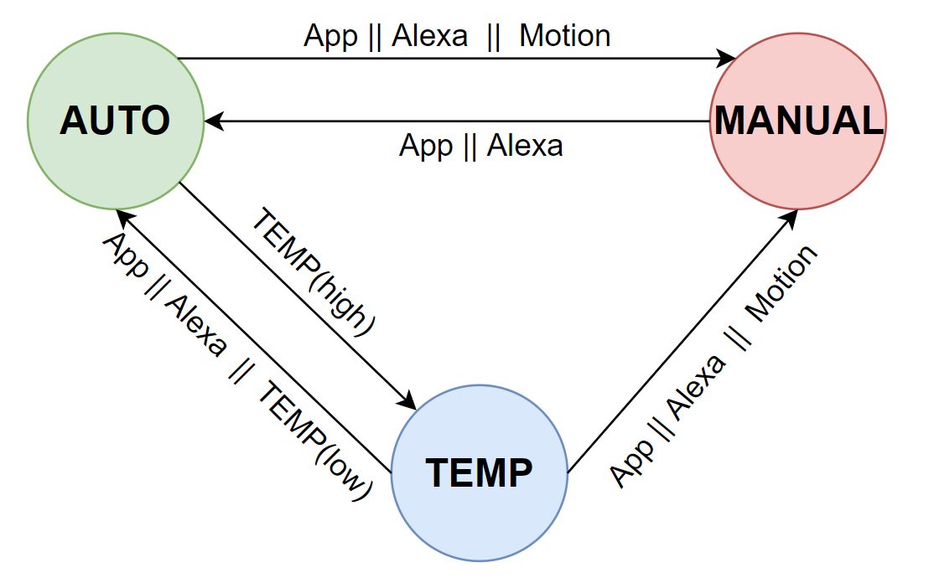
Software Design
Notes:
Mandy

Slide 8
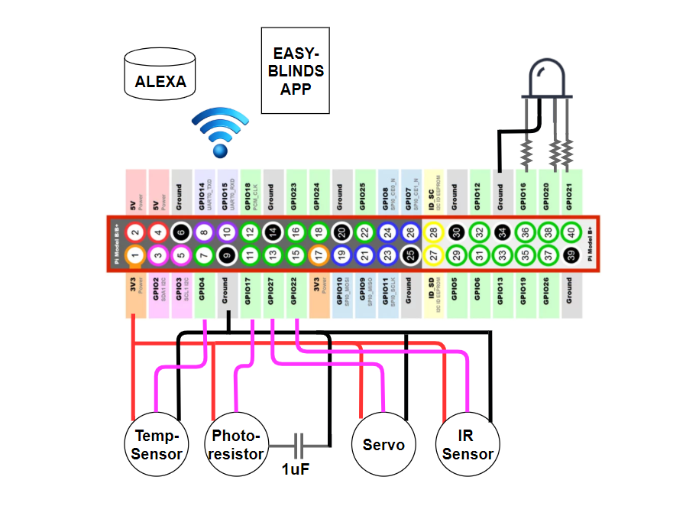
Hardware Design

Slide 9
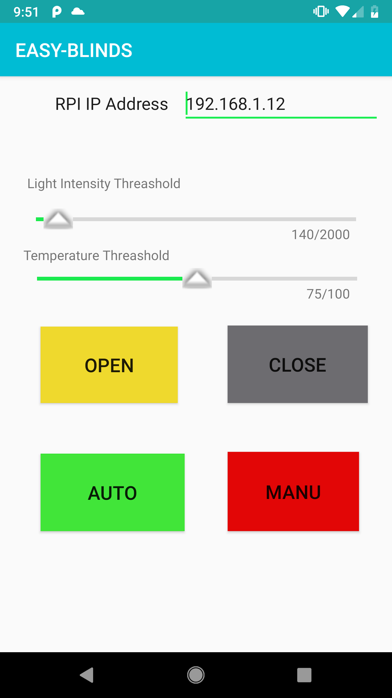
EASY-BLINDS APP
Client-Server Socket Programming
Socket programming is a way of connecting two devices across a network
The Server (RPi) Socket/node listens on a particular port “8080” at an IP address “RPis IP”
The Client (APP) Socket sends data to that IP address
APP Functions
Set Light Intensity Threshold
Set Temperature Threshold
Open Blinds
Close Blinds
Set to Auto Mode
Set to Manual Mode

Slide 10
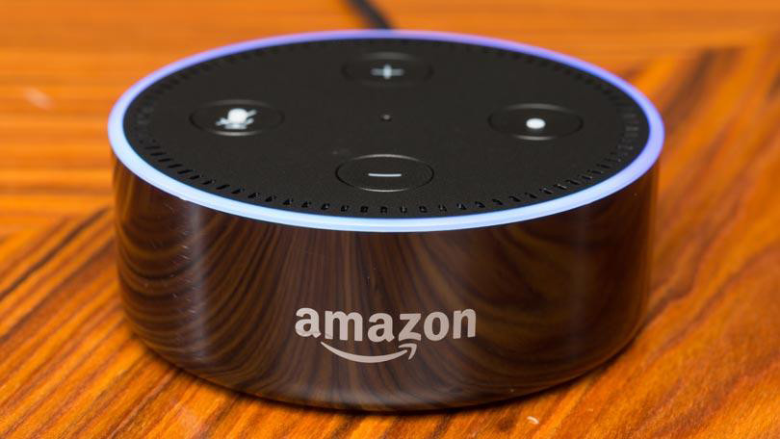
Easy-Blinds w/ Alexa
Uses Fauxmo Module
Simple to set up
Can use different Alexa devices
Consists of 2 devices
It works using 3 voice identifiers

Slide 11
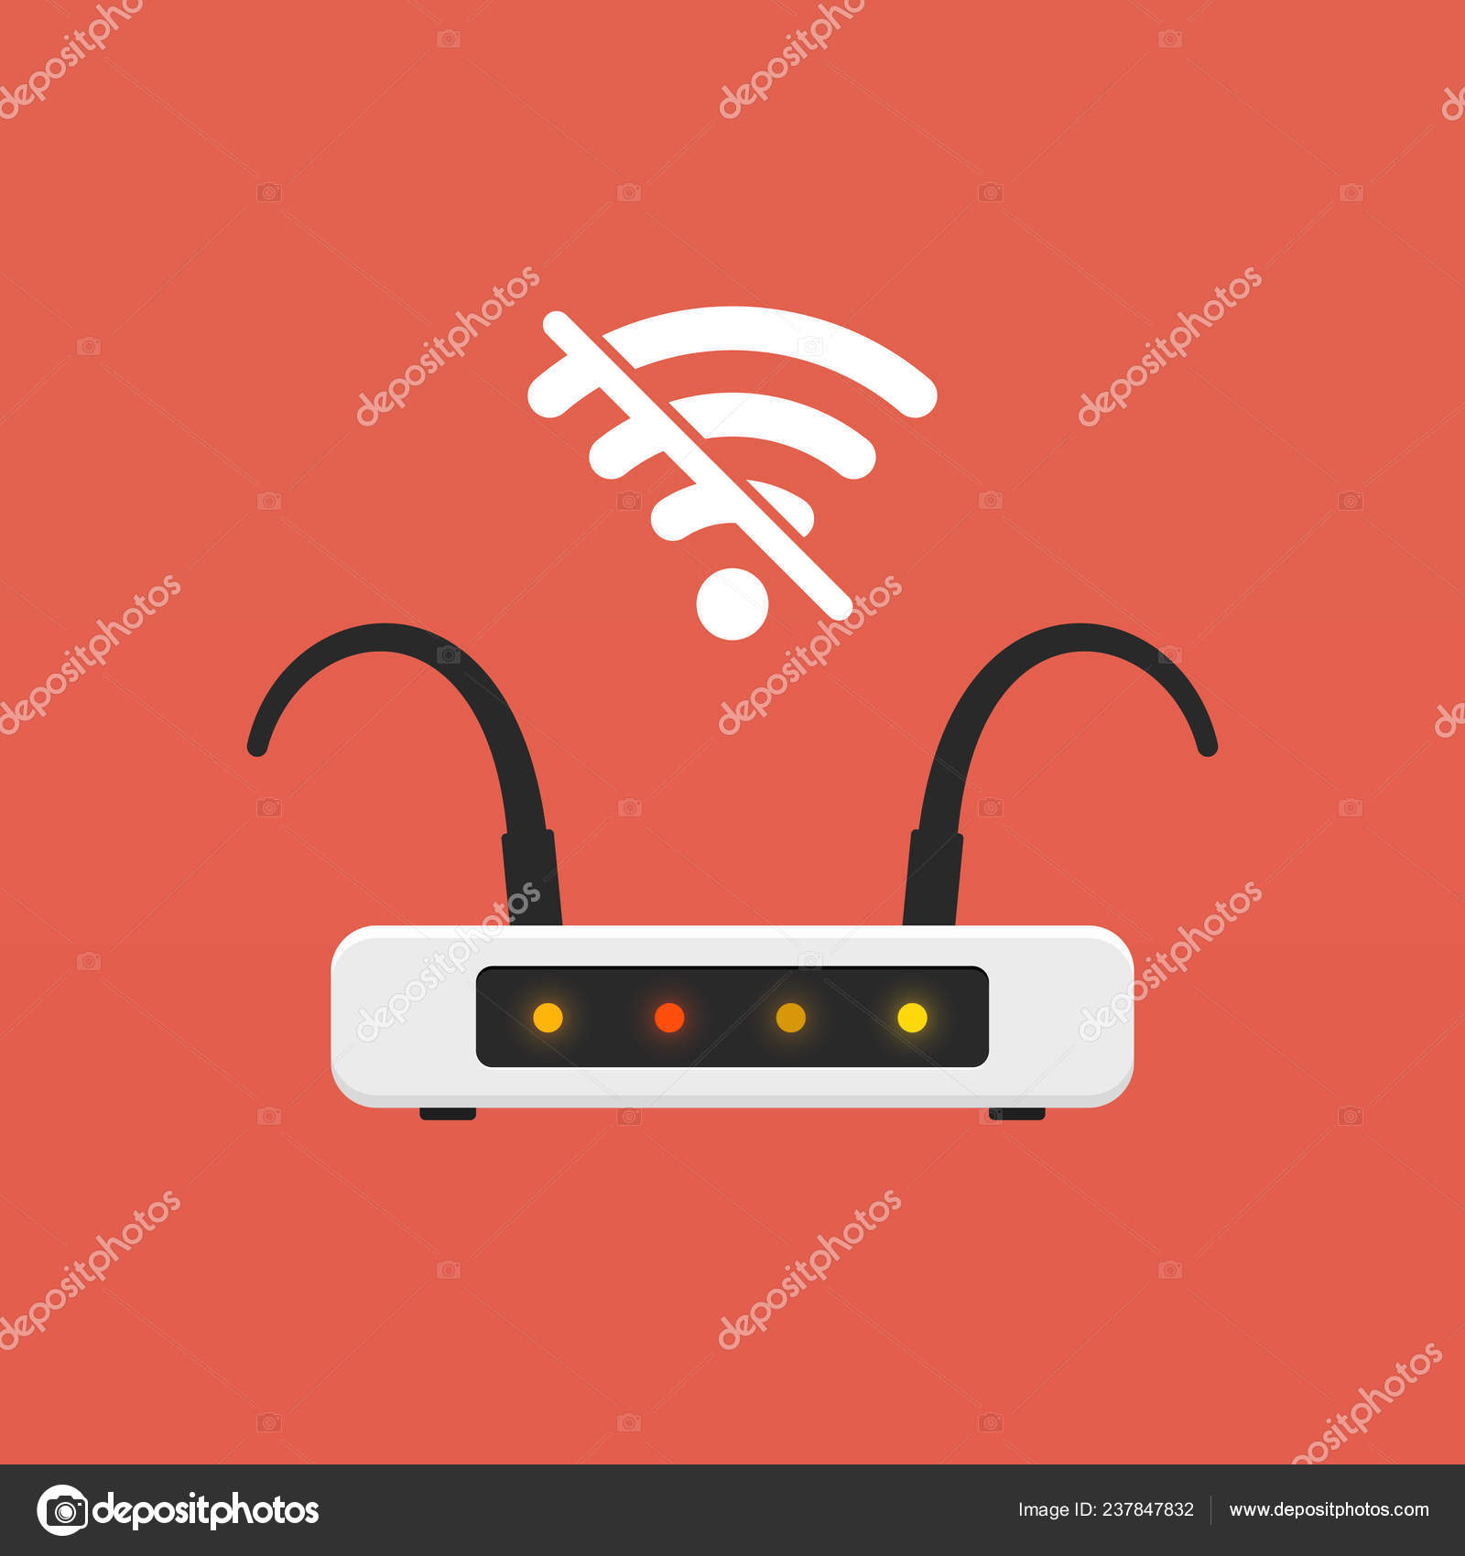
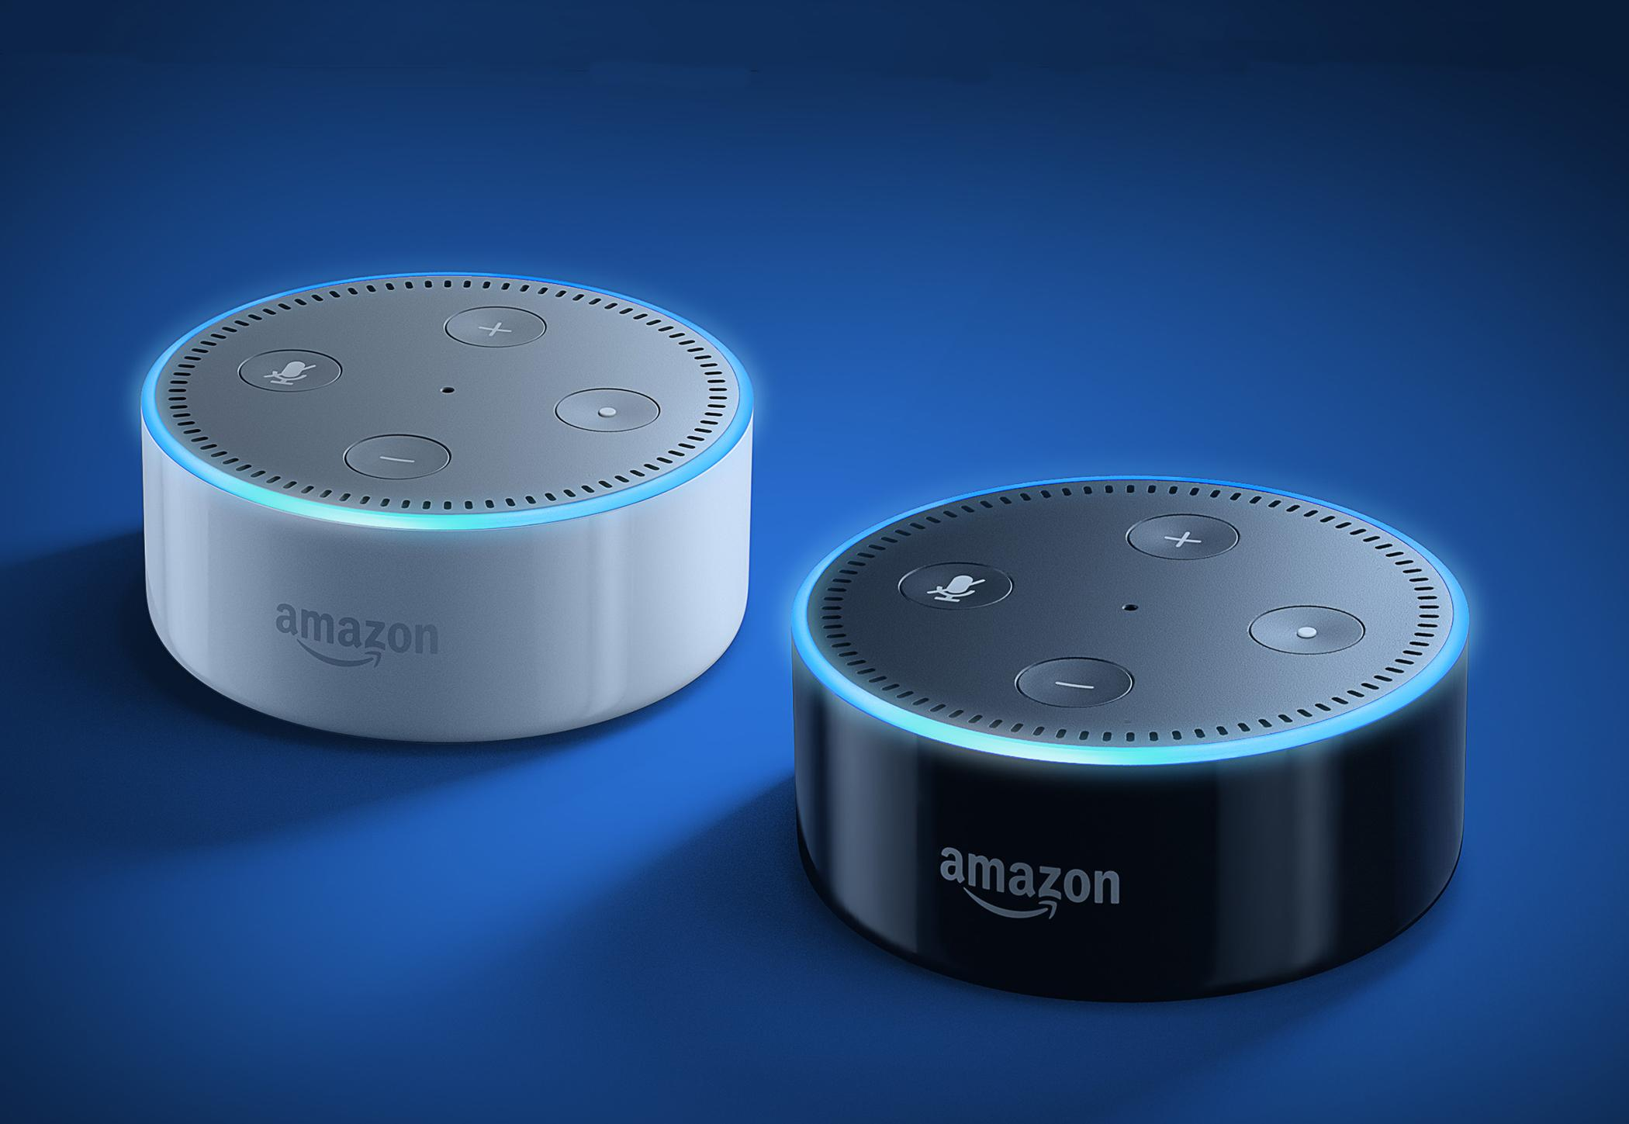
Challenges Surrounding Easy-Blinds
When initially testing the communication between the APP and the RPi, a connection could not be made.
Original method connecting to Alexa was tedious, time consuming, and difficult.
Notes:
Mandy

Slide 12
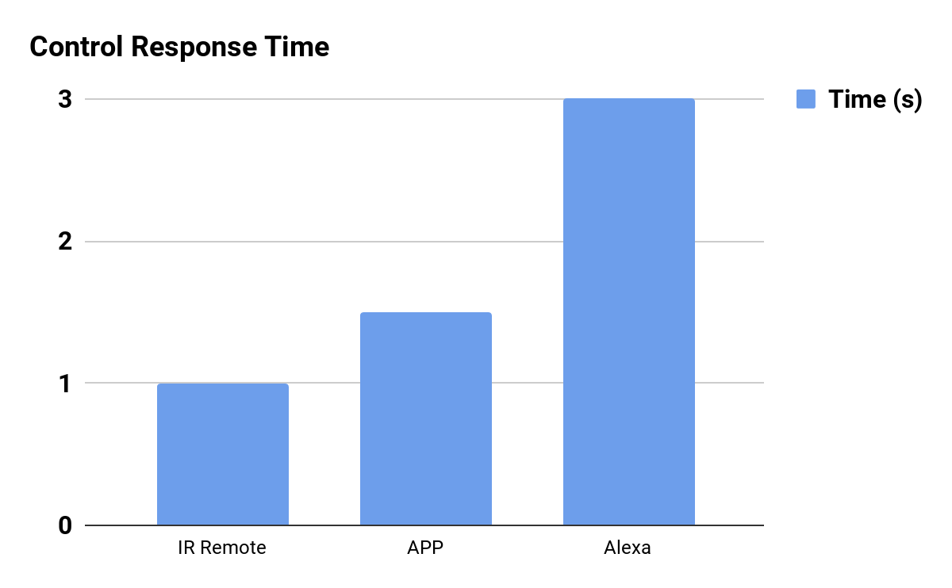
Evaluation / Findings
Although the IR Remote showed the fastest response time, it was highly subject to interference (as seen last quarter while setting up our presentation)

Slide 13
Future improvements
Pre-soldered circuit board
3D print a mounting mechanism
Can be sold as a kit
Create a home network of blinds under one control system
Add Google Assistant functionality

Slide 14
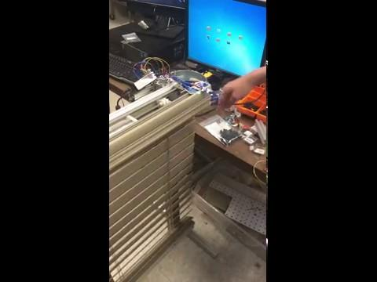
Previous Capabilities -- Light and Motion

Slide 15
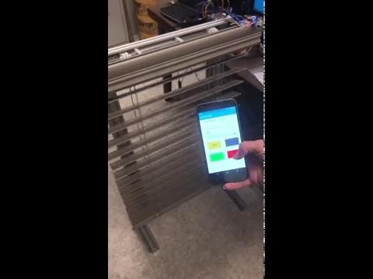
APP Open and Close

Slide 16
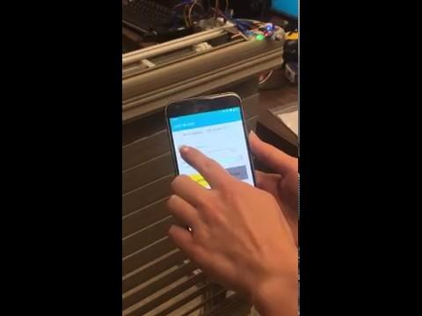
APP Light Intensity Threshold

Slide 17
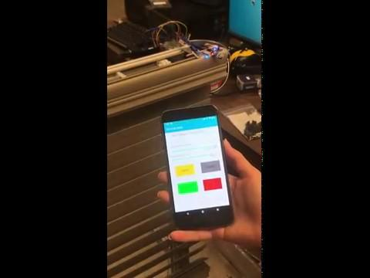
APP Temperature Threshold

Slide 18
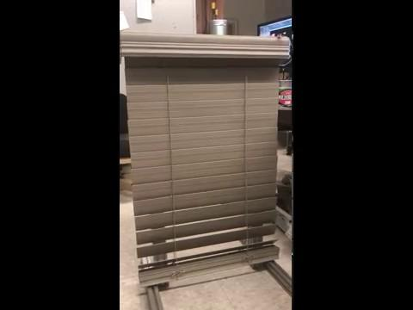
Alexa Open and Close

Slide 19
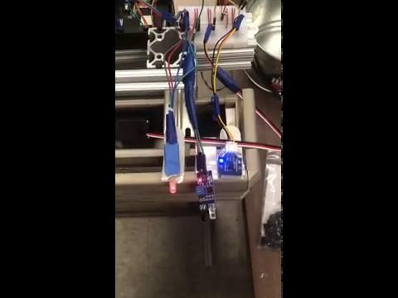
Alexa Auto and Manual Modes

Slide 20
Thank you,
Any questions?

